Slide 1
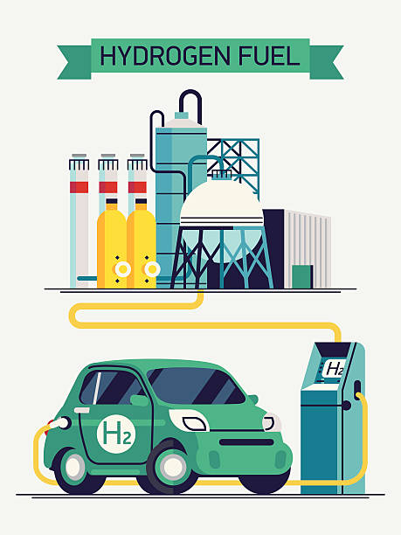
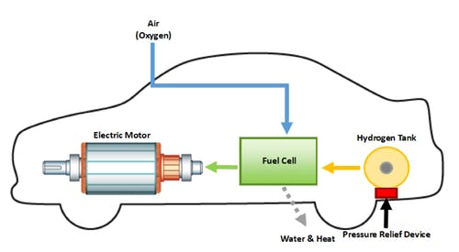
WELCOME TO THE FUTURE !!!!
Topic:- Hydrogen Fuel Cells
Group Members :-
201 – Navneet Tiwari
202 – Ruchik Bhokare
203 – Nikhil Kulkarni
204 – Vinay Waghmare
205 – Shreyas Kharche

Slide 2
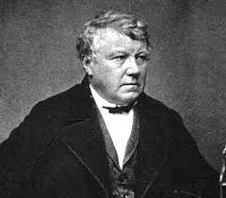
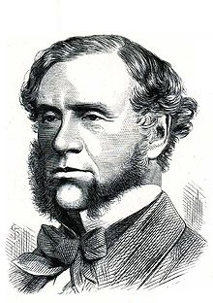
Hydrogen Fuel Cells
Hydrogen Fuel cell was first discovered by German
Scientist Christian Friedrich Schoenbein in 1838.
Hydrogen Fuel cell was first demonstrated by
Welsh Scientist William Robert Grove in 1839.
Hydrogen Energy
Hydrogen is the simplest and the most plentiful element in the universe.
It’s always combined with other elements.
Hydrogen is high in energy, yet an engine that burns pure hydrogen produces almost no pollution.
NASA has used liquid hydrogen since the1970s to propel the space shuttle and other rockets into orbit.
Christian Schoenbein
William Grove

Slide 3
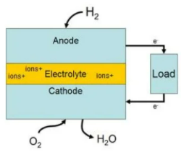
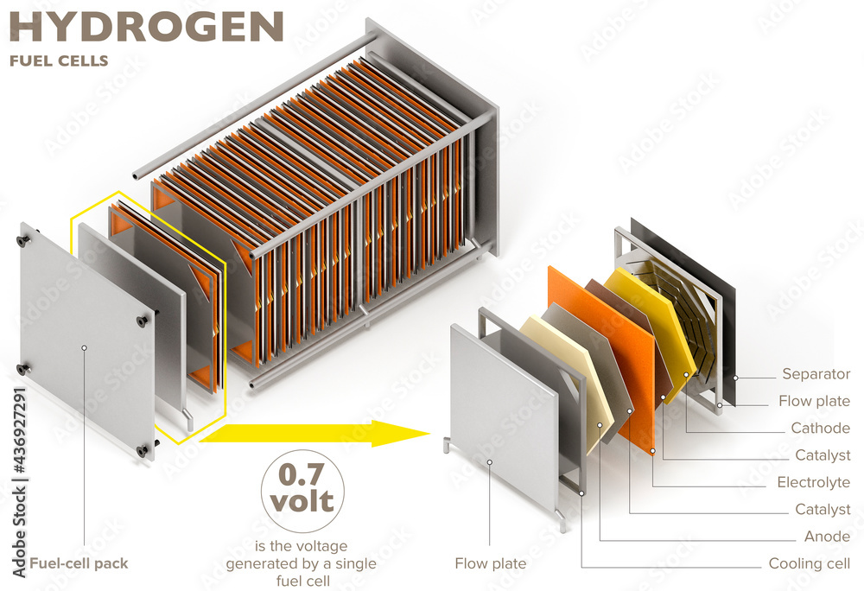
What is Fuel Cell ?
A Fuel Cell is an electrochemical device that combines hydrogen and oxygen to produce electricity, with water and heat as its by-product.
Overall reaction:
oxidation of a fuel oxygen
2H2(g) + O2(g) → 2H₂O)
(Hydrogen) Fuel + oxygen → water

Slide 4
IMPORTANCE OF HYDROGEN
Fuel Cells require highly purified hydrogen as a fuel.
Researchers are developing a wide range of technologies to produce hydrogen economically from a variety of resources in environmentally friendly ways.
There are three general ways of producing Hydrogen:-
Thermal Process
Electrolyte Process
Photolytic Process
Regenerative Fuel Cells
▪ Currently researched by NASA.
▪ This type of fuel cell involves a closed loop form of power generation.
▪ Uses solar energy to separate water into hydrogen and oxygen.
▪ Hydrogen and oxygen are fed into the fuel cell generating electricity, heat and water.
▪ The water by product is then recirculated back to the solar-powered electrolyser beginning the process again.

Slide 5
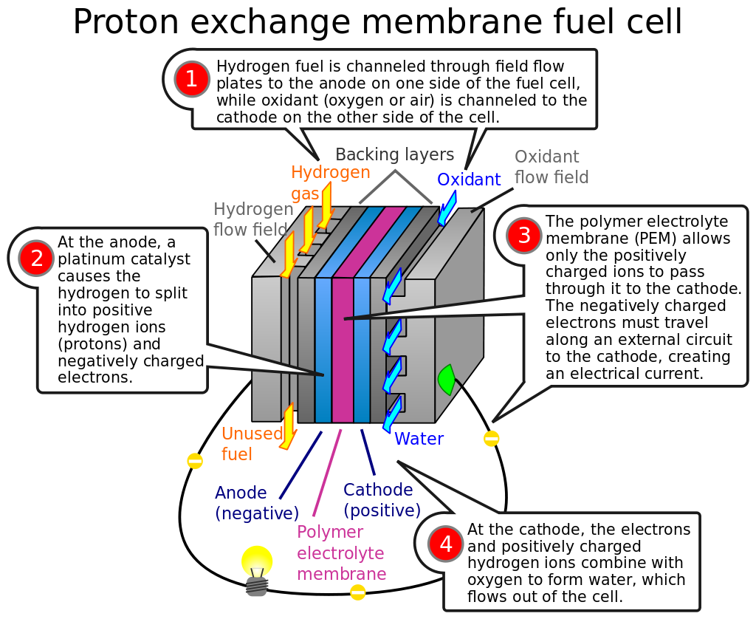
Working of fuel cells

Slide 6
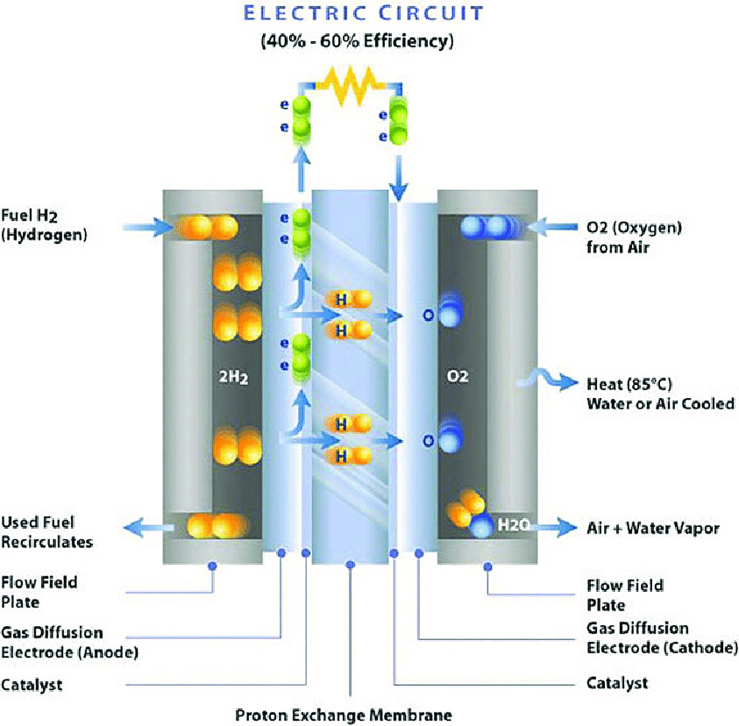
Fuel cell structure

Slide 7
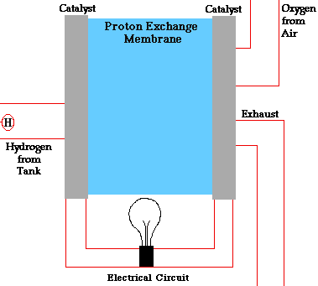
How does fuel cell work
The purpose of a fuel cell is to produce an electrical current that can be directed outside the cell to do work, such as powering an electric motor or illuminating a light bulb or a city. Because of the way electricity behaves, this current returns to the fuel cell, completing an electrical circuit. The chemical reactions that produce this current are the key to how a fuel cell works.
There are several kinds of fuel cells, and each operates a bit differently. But in general terms, hydrogen atoms enter a fuel cell at the anode where a chemical reaction strips them of their electrons. The hydrogen atoms are now "ionized," and carry a positive electrical charge. The negatively charged electrons provide the current through wires to do work. If alternating current (AC) is needed, the DC output of the fuel cell must be routed through a conversion device called an inverter.
Oxygen enters the fuel coil at the cathode and, in some cell types (like the one illustrated above), it there combines with electrons returning from the electrical circuit and hydrogen ions that have traveled through the electrolyte from the anode. In other cell types the oxygen picks up electrons and then travels through the electrolyte to the anode, where it combines with hydrogen ions.
The electrolyte plays a key role. It must permit only the appropriate ions to pass between the anode and cathode. If from electrons or other substances could travel through the electrolyte, they would disrupt the chemical reaction

Slide 8
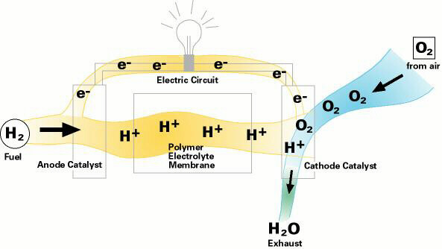
Whether they combine at anode or cathode, together hydrogen and oxygen form water, which drains from the cell. As long as a fuel cell is supplied with hydrogen and oxygen, it will generate electricity.
Even better, since fuel cells create electricity chemically, rather than by combustion, they are not subject to the thermodynamic laws that limit a conventional power plant. Therefore, fuel cells are more efficient in extracting energy from a fuel. Waste heat from some cells can also be harnessed, boosting system efficiency still further.
Hydrogen Fuel Cell Efficiency
40% efficiency converting methanol to hydrogen in reformer
• 80% of hydrogen energy content converted to electrical energy
• 80% efficiency for inverter/motor
• Overall efficiency of 24-32%

Slide 9
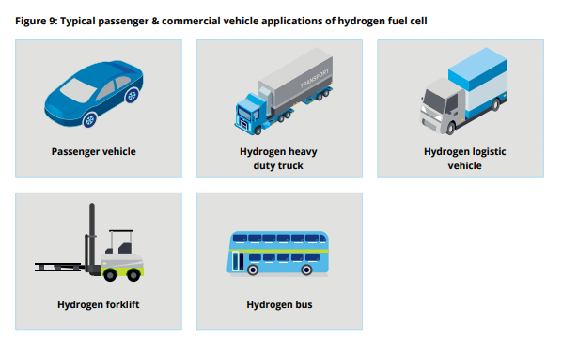

Fuel cell vehicle applications
Hydrogen bin truck
Notes:
Fuel cells for transportation include a wide range of use cases such as passenger vehicles…...
We will focus on passenger and commercial vehicle applications of fuel cell technology, which is perhaps one of the areas showing highest signs of promise for widespread adoption.

Slide 10
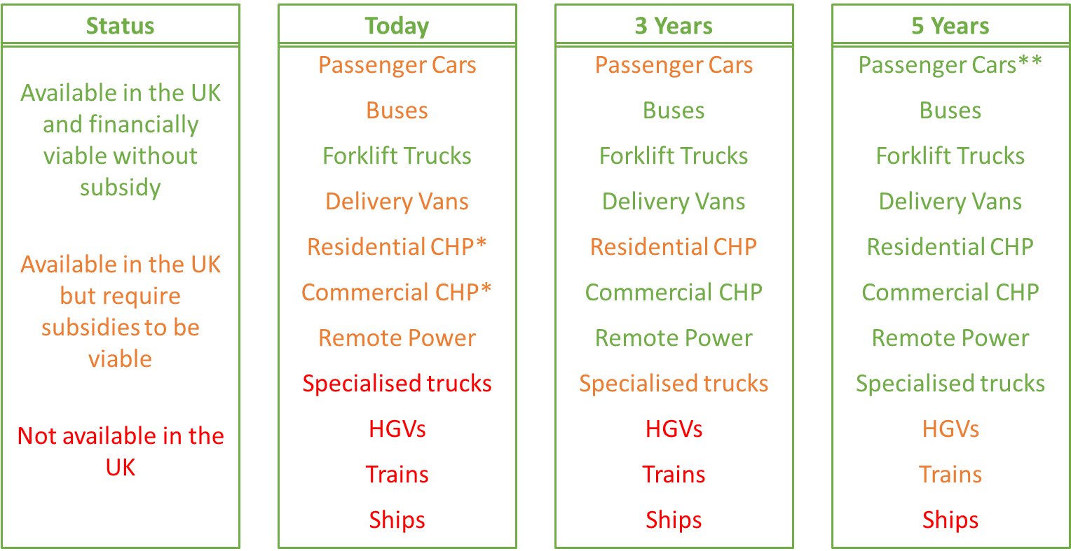
Applications & commercial status
Many fuel cell products are available today and they are becoming a commercial option
The most commercially advanced application is in forklift trucks for large 24/7 warehouse operations or in cold store situations, where batteries do not work well. They have a higher capital cost than the conventional lead acid batteries that are widely used, but a significantly lower operating cost.
Fuel cell cars are available in the UK from Toyota, Honda and Hyundai. Their numbers are limited as producers have not yet invested in large-scale, low-cost manufacture but we can expect this to happen within 5 years. This will also give time for a hydrogen refuelling infrastructure to be developed. Vans, buses and vehicles like refuse trucks are a good near term application as they often return ‘back to base’ on a daily basis. This provides a better investment case for a dedicated refuelling station.
Another near term application is large-scale, commercial combined heat and power (CHP). Although they use natural gas like conventional CHP units and produce CO₂, they are cleaner in operation and more efficient on a total electricity and heat basis. This is a good option where local air quality is a concern.
Larger HGVs, trains and ships are also being developed but these are a longer term option.

Slide 11
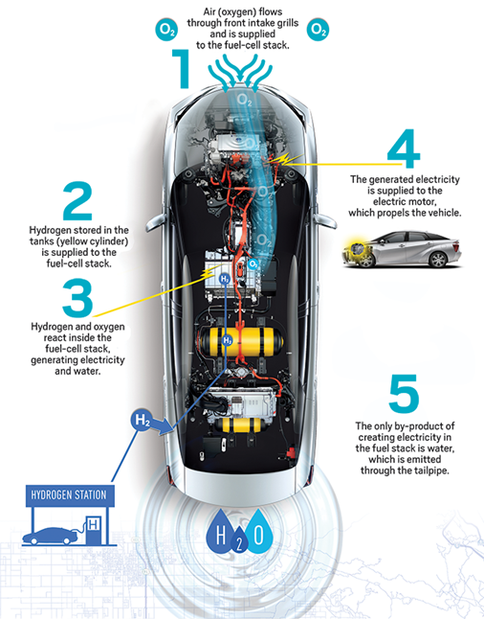
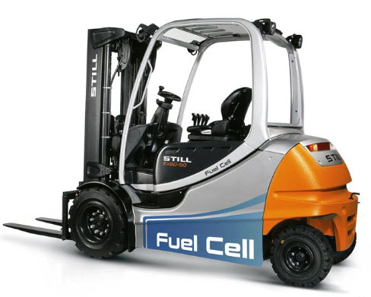
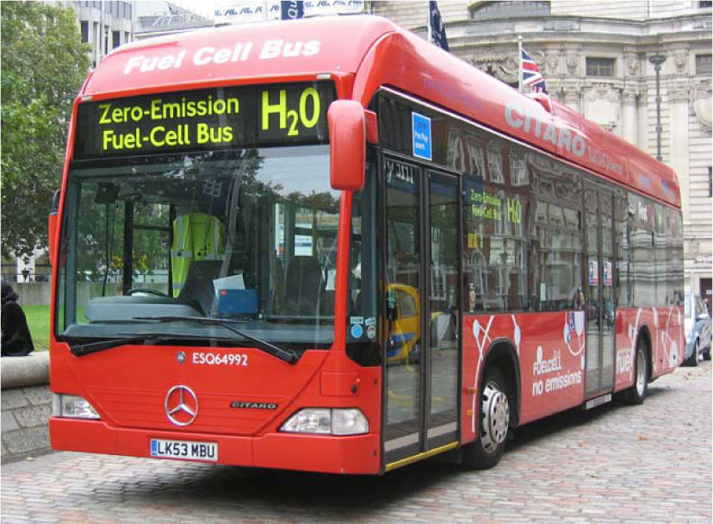
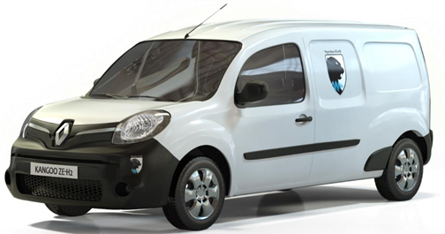

Fuel cell vehicles
Forklift trucks
More than 20,000 supplied in the US to companies such as Walmart, Toyota, Sysco and Amazon. Products from Plug Power, Hyster Yale, Still and Toyota.
Cars
Buses
Fast growing application with major deployments in China and the US. In the UK, FC buses are already operating in London (8) and Aberdeen (10) with more planned for Birmingham and Dundee.
Delivery vans
A significant number of vans are in operation in the UK. These are a modified Renault Kangoo battery electric van with a fuel cell installed to extent their range from 80 to 150km
Refuse trucks
Aside from prototypes, fuel cell refuse trucks are not widely used today although they are expected to be available from late 2018.

Slide 12
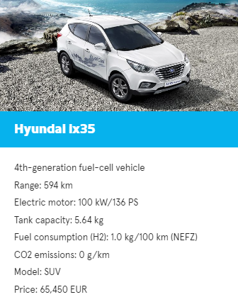
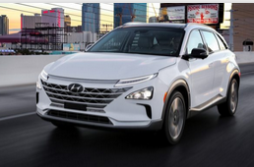
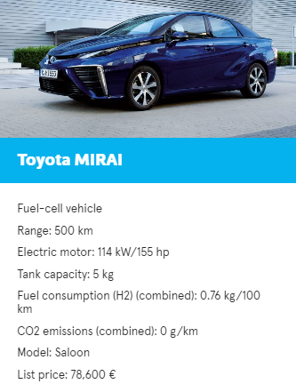
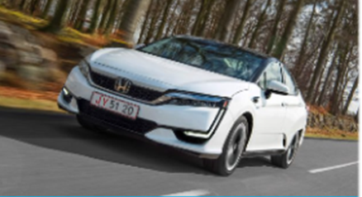

FCEV Passenger cars
Hyundai ix35
Hyundai NEXO
Toyota MIRAI
Honda Clarity Fuel Cell
Mercedes-Benz GLC F-CELL
Notes:
They are all FCEV (Fuel Cell Electric Vehicles) but Mercedes-Benz, which is a FCPHEV (Fuel Cell Plug-in Hybrid Electric Vehicle)
H2.LIVE: Hydrogen Stations in Germany & Europe
Average range: 600 kms

Slide 13
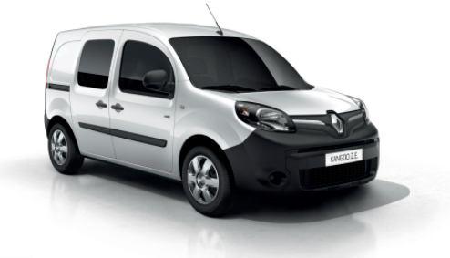
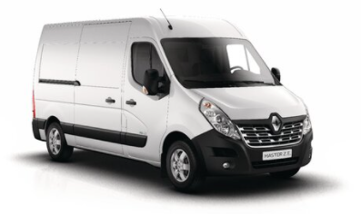
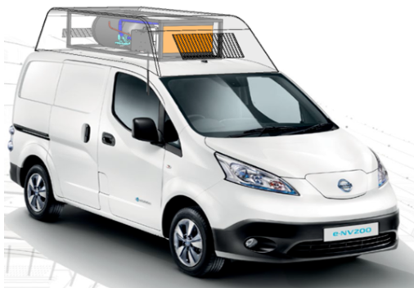
FCEV Range Extended Vans
Renault Kangoo Z.E. Hydrogen
Renault Master Z.E. Hydrogen
Nissan e-NV200
Notes:
Symbio – Zero emission mobility solutions
En pruebas desde 2014, la tecnología de hidrógeno del Grupo Renault se ha desarrollado en colaboración con Symbio, filial del Grupo Michelin. Los vehículos están equipados con una pila de combustible extensor de alcance con 10 kW de energía eléctrica y térmica, lo que permite al renault Master Z.E. Hydrogen y Renault Kangoo Z.E. Hydrogen alcance a más de 350 km. Otra ventaja del hidrógeno es un tiempo de recarga de sólo 5 a 10 minutos. El hidrógeno se utiliza para responder a usos intensivos, no cubiertos por el vehículo eléctrico, especialmente para largas distancias a áreas suburbanas.

Slide 14
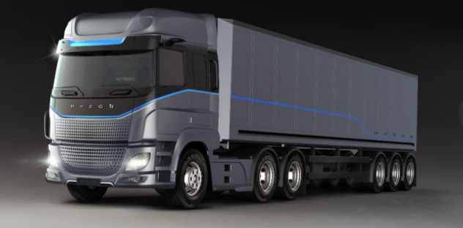
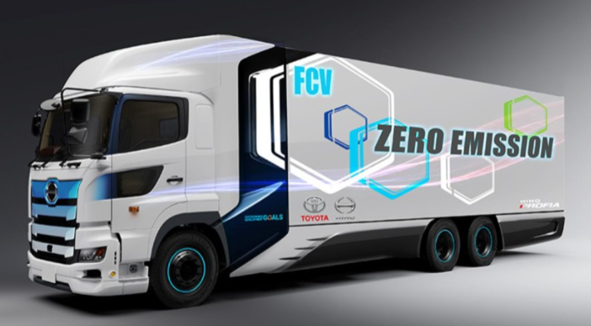
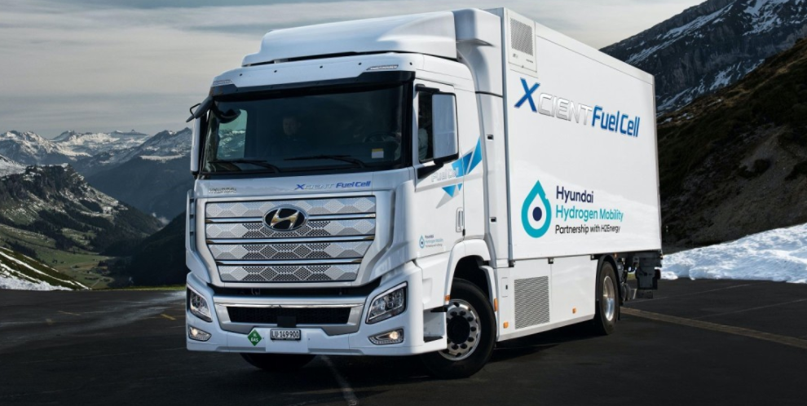
FCEV Trucks
Hyzon Hydrogen Heavy Truck
Toyota Hino Profia FC
Hyundai Xcent Fuel Cell

Slide 15

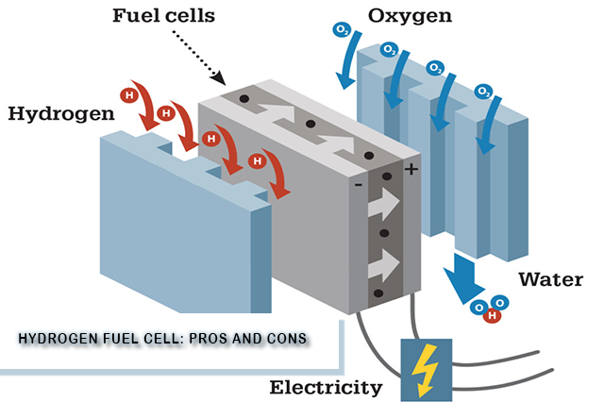
INTRODUCTION.
ADVANTAGES
OF
H2 FUEL CELLS

Slide 16
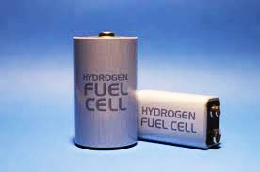
INTRODUCTION.
It is readily available.
It doesn't produce harmful
emissions.
It can be used as fuel
In rockets.
It is fuel-efficient.
It is renewable.

Slide 17
INTRODUCTION.
DISADVANTAGES
OF
H2 FUEL CELLS

Slide 18
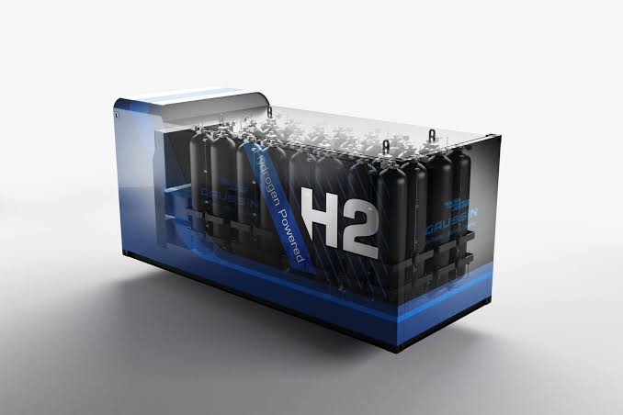
.
INTRODUCTION. It i
It is difficult to store.
It is expensive.
It is not easy to replace the existing infrastructure.
Fossil fuels are often used to produce it.
It is highly flammable.

Slide 19
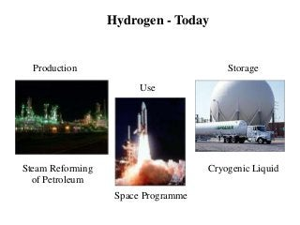
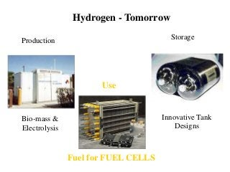
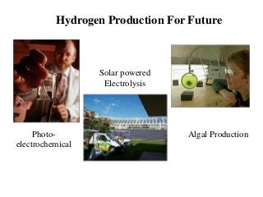







Hydrogen-Today
Hydrogen - Tomorrow
Production
Storage
Production
Storage
Use
Use

Slide 20

Conclusion
As discussed, Hydrogen is a fuel having a high heat value and benefits of being a green fuel. Also with increased focus by countries across the world in R&D of extracting hydrogen, it is certain that Hydrogen would be the fuel of the future.
Hydrogen storage is still the major issue of concern, and lot of work is still expected on this sector. Considering Indian economy, switching to hydrogen will surely decrease the oil imports of nation and dependency on other nations for energy resource supply.

Slide 21



